Slide 1
Dynamics
pre-class (1 to 10)
IN-Class (12 onwardS)

Slide 2
Dynamics
Dynamics describes the relationship between the motion of an object and the forces that cause the motion.
Dynamics answers questions such as why it is harder to control a car on a wet icy road than on a dry road, or how a rocket is able to propel itself upward.
We will study the laws of physics which describe nature in the macroscopic world.

Slide 3
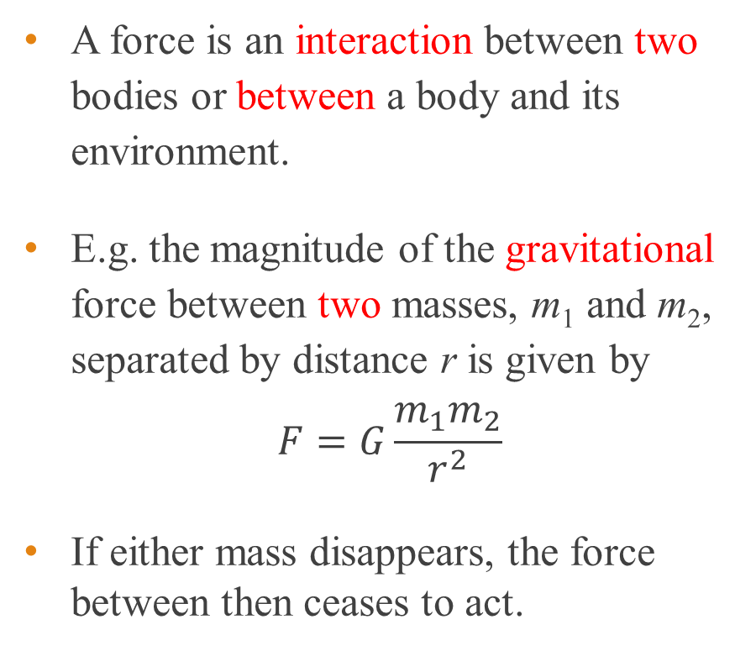
Force
A force is an interaction between two bodies or between a body and its environment.
E.g. the magnitude of the gravitational force between two masses, m₁ and m₂, separated by distance r is given by
$$F=G\frac{m_{1}m_{2}}{r^{2}}$$
If either mass disappears, the force between then ceases to act.
m₁
m₂
r

Slide 4
Long range force vs contact force
Contact force arises when there is contact between objects. Examples are kicking a ball, pushing a cart, etc.
Long-range force is felt even when the objects are not in physical contact. Examples are the gravitational pull between the Earth and the Moon, the repulsion between like electric charges, etc.
The gravitational pull the earth exerts on you is known as your weight .

Slide 5
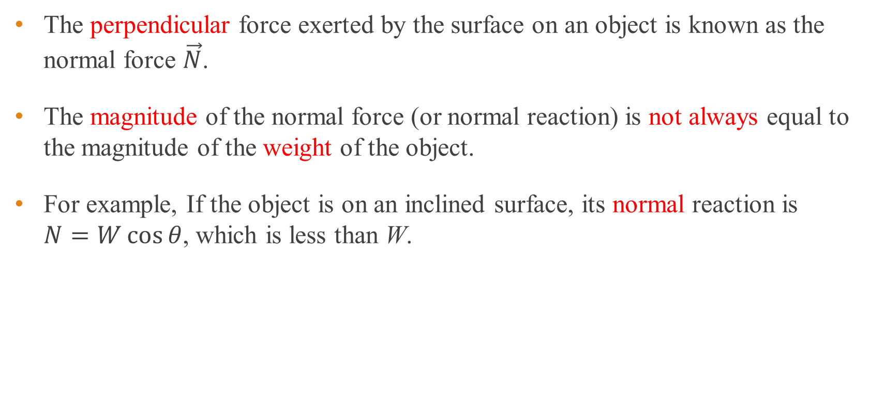
Contact force – normal force
The perpendicular force exerted by the surface on an object is known as the normal force $\vec{N}$.
The magnitude of the normal force (or normal reaction) is not always equal to the magnitude of the weight of the object.
For example, If the object is on an inclined surface, its normal reaction is $N=W\cos{θ}$, which is less than W.
θ

Slide 6
Contact force – Friction
Frictional force or just friction occurs when a surface resists motion of an object that is in contact with the surface.
The direction of the kinetic frictional force is always opposite to the direction of the force causing the motion.
Direction of frictional force
Direction of applied force

Slide 7
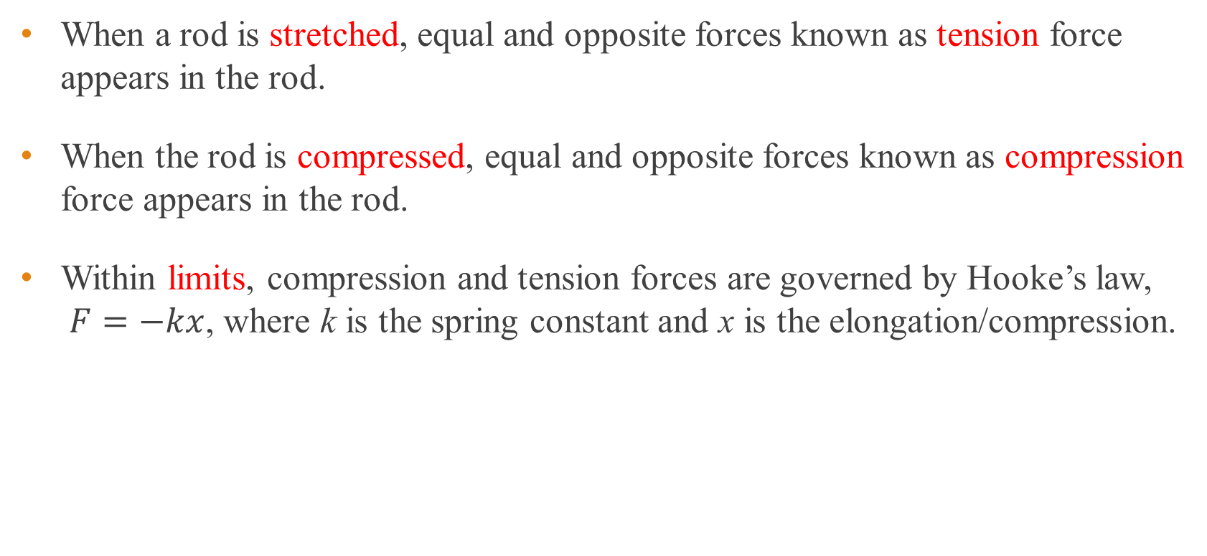
Contact force – Tension and compression
When a rod is stretched, equal and opposite forces known as tension force appears in the rod.
When the rod is compressed, equal and opposite forces known as compression force appears in the rod.
Within limits, compression and tension forces are governed by Hooke’s law, $F=−kx$, where k is the spring constant and x is the elongation/compression.
Pull
Push

Slide 8
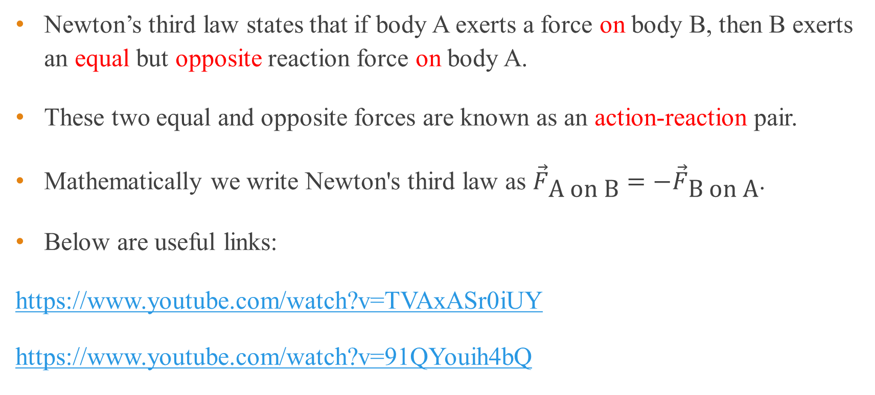
Newton’s third law of motion
Newton’s third law states that if body A exerts a force on body B, then B exerts an equal but opposite reaction force on body A.
These two equal and opposite forces are known as an action-reaction pair.
Mathematically we write Newton's third law as ${\vec{F}}_{\text{A} \text{on} \text{B}}=−{\vec{F}}_{\text{B} \text{on} \text{A}}$.
Below are useful links:
https://www.youtube.com/watch?v=TVAxASr0iUY
https://www.youtube.com/watch?v=91QYouih4bQ

Slide 9
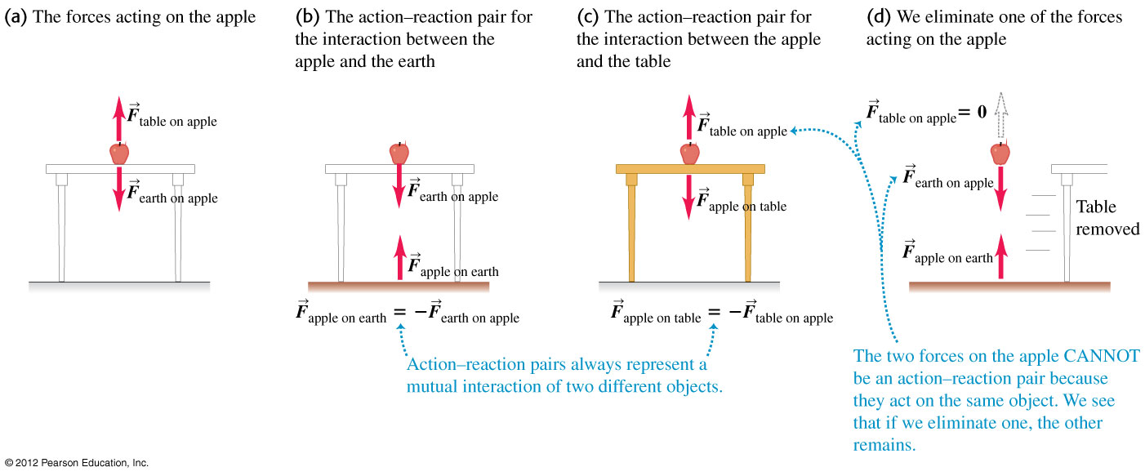
Example 1
An apple sitting at rest on a table is in equilibrium.
a) What forces act on the apple?
b) What is the reaction force to each of the forces acting on the apple?
c) What are the action-reaction pairs?

Slide 10
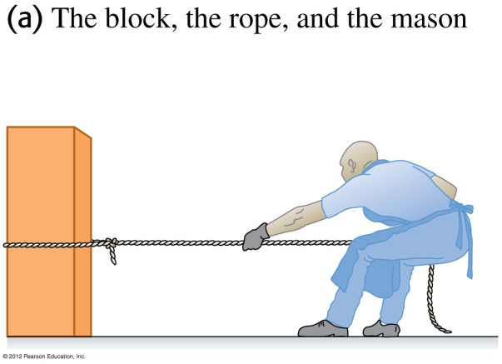
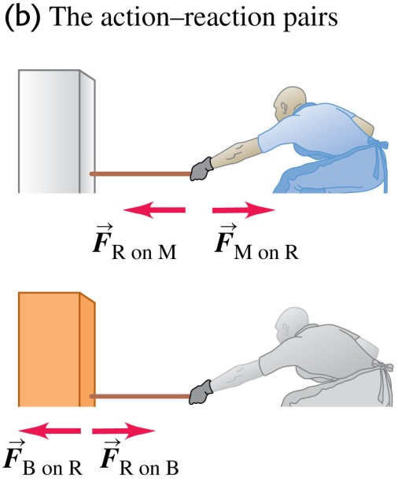
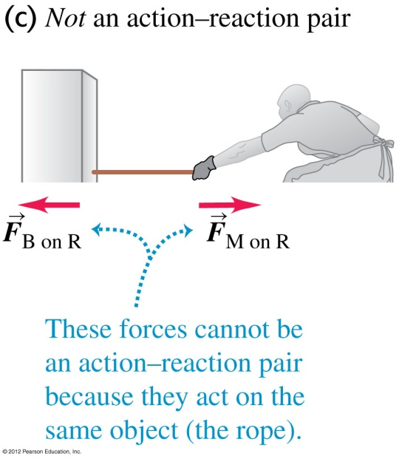
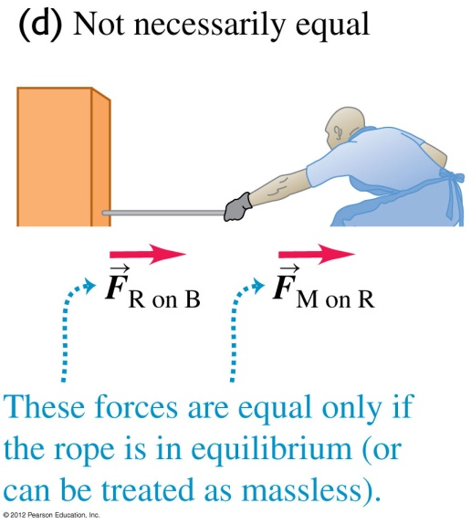
Example 2
A stone mason drags a marble block across a floor by pulling on a rope attached to the block (see figure). The block is not necessarily in equilibrium.
a) How are the various forces related?
b) What are the action-reaction pairs?

Slide 11
End of pre-class slides

Slide 12
Newton’s first law of motion
Every body continues in its state of rest or uniform motion (constant velocity) unless a net force acts on it to change that state.
You do not need a force to sustain motion!
Inertia is the property of a body which resists change in its state of motion.
The larger the mass, the greater its inertia.

Slide 13
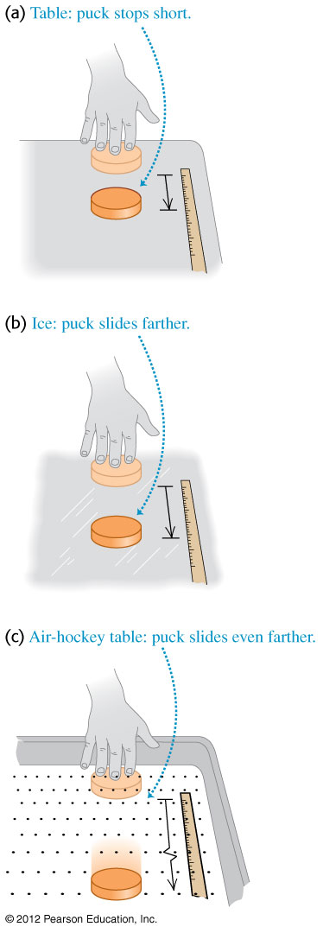
Newton’s first law of motion
In the first two scenarios below, the pucks move different distances because of difference in frictional forces.
In the third scenario, friction is totally absent and the puck moves with constant velocity, i.e. constant speed in a straight line.

Slide 14
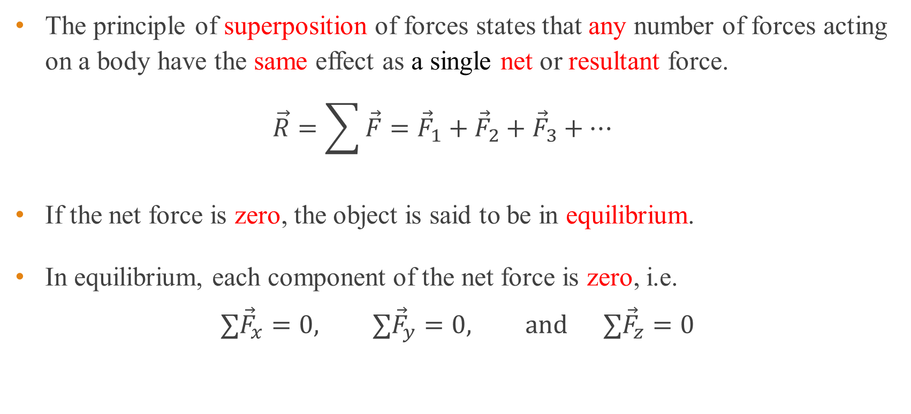
Superposition of forces
The principle of superposition of forces states that any number of forces acting on a body have the same effect as a single net or resultant force.
$$\vec{R}=\sum{\vec{F}}={\vec{F}}_{1}+{\vec{F}}_{2}+{\vec{F}}_{3}+…$$
If the net force is zero, the object is said to be in equilibrium.
In equilibrium, each component of the net force is zero, i.e.
$$∑{\vec{F}}_{x}=0, ∑{\vec{F}}_{y}=0, \text{and} ∑{\vec{F}}_{z}=0$$

Slide 15
Newton’s first law as the law of inertia
A frame of reference in which Newton’s first law is valid is known as an inertial frame of reference.
Since we define an inertial frame of reference using Newton’s first law we refer to this law as the law of inertia.
A non-inertial frame of reference is an accelerating frame where Newton’s first law is not valid.
Notes:
The earth can be assumed to be an inertial frame of reference if we ignore effects of the rotation of the earth as well as the earth’s motion around the sun.
If a frame of reference, B, moves with constant velocity with an inertial frame of reference, A, then B is also an inertial frame of reference.

Slide 16
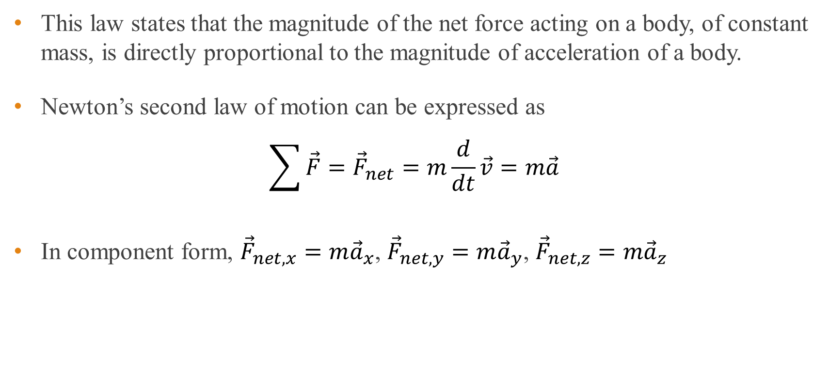
Newton’s second law of motion
This law states that the magnitude of the net force acting on a body, of constant mass, is directly proportional to the magnitude of acceleration of a body.
Newton’s second law of motion can be expressed as
$$\sum{\vec{F}}={\vec{F}}_{net}=m\frac{d}{dt}\vec{v}=m\vec{a}$$
In component form, ${\vec{F}}_{net, x}=m{\vec{a}}_{x}$, ${\vec{F}}_{net,y}=m{\vec{a}}_{y}$, ${\vec{F}}_{net,z}=m{\vec{a}}_{z}$

Slide 17
Definition of one newton
Newton’s second law is used to define the magnitude of one newton.
One newton (N) is the net force that gives a mass of one kilogram an acceleration of one metre per second square.
Mathematically, 1 N = 1 kg × 1 m/s².

Slide 18
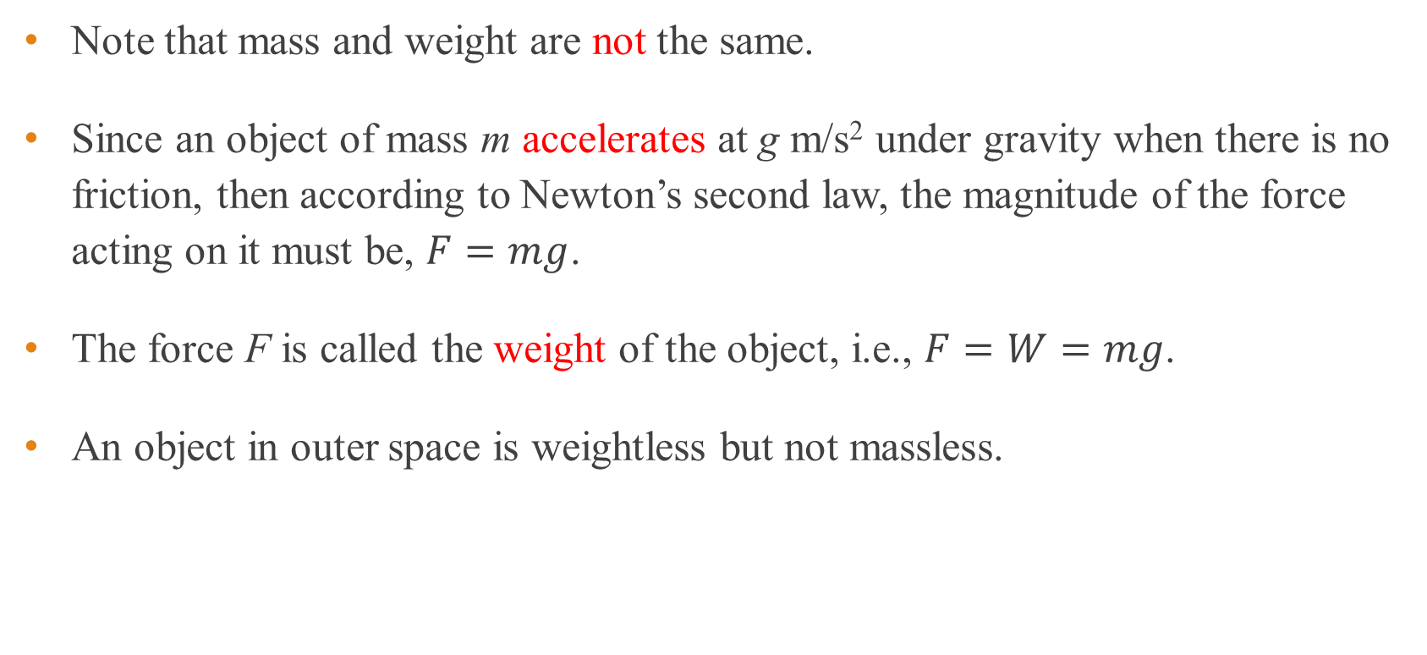
Mass and weight of an object
Note that mass and weight are not the same.
Since an object of mass m accelerates at g m/s² under gravity when there is no friction, then according to Newton’s second law, the magnitude of the force acting on it must be, $F=mg$.
The force F is called the weight of the object, i.e., $F=W=mg$.
An object in outer space is weightless but not massless.

Slide 19
Newton’s laws are not valid in non-inertial frames
Suppose person on roller skates is on a bus moving at constant velocity.
If the bus suddenly speeds up/slows down, the person starts moving backward/forward.
Newton’s second law does not seem to be obeyed as without any net force on the person, the velocity of the person changes.
This is because the bus is accelerating with respect to earth and is not an inertial frame.

Slide 20
Free-body diagram
Free-body diagrams are diagrams used to show the magnitude and direction of all forces acting upon an object in a given situation.
When drawing a free-body diagram, we choose an object of interest and draw all the forces acting on it due to other bodies.
Forces that the object of interest exerts on other bodies are not included.

Slide 21
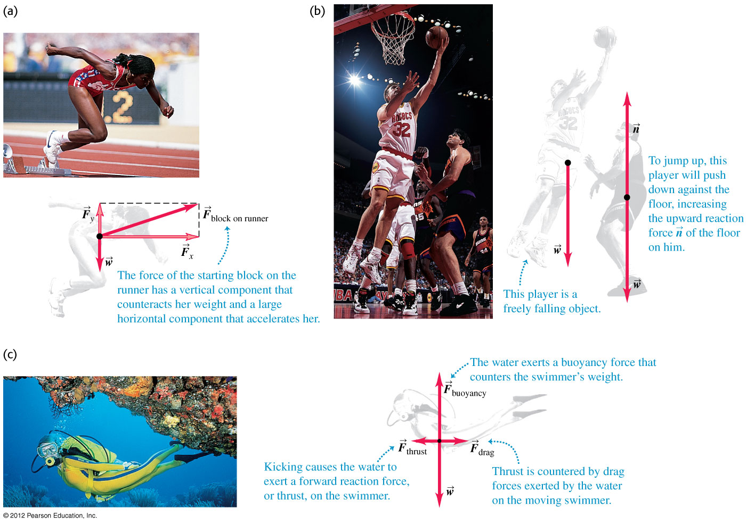
Examples of free-body diagrams

Slide 22
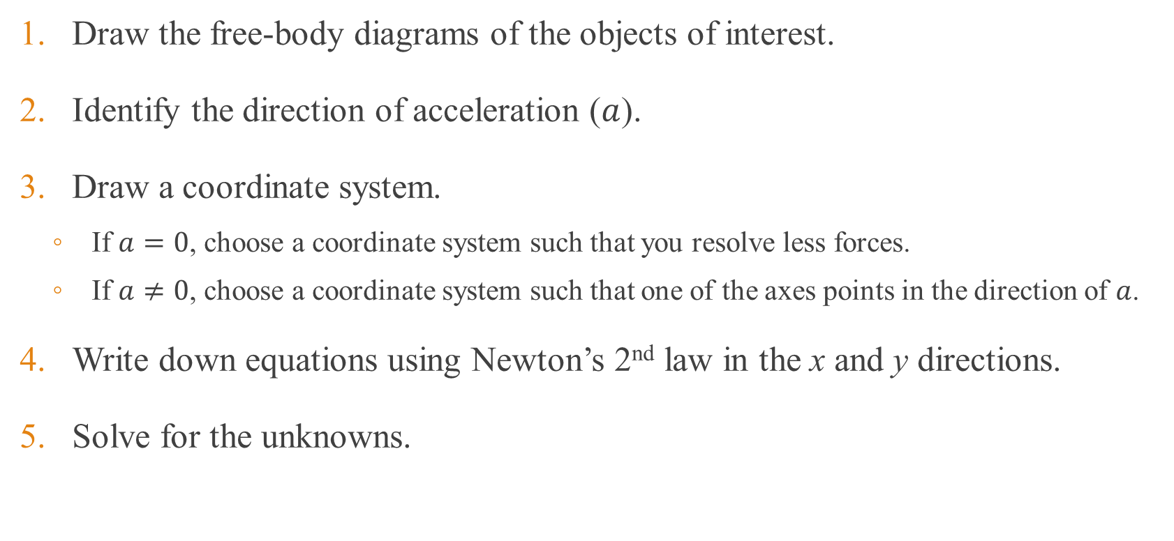
Problem solving strategy involving Newton’s 2nd law
Draw the free-body diagrams of the objects of interest.
Identify the direction of acceleration ($a$).
Draw a coordinate system.
If $a=0$, choose a coordinate system such that you resolve less forces.
If $a≠0$, choose a coordinate system such that one of the axes points in the direction of $a$.
Write down equations using Newton’s 2nd law in the x and y directions.
Solve for the unknowns.

Slide 23
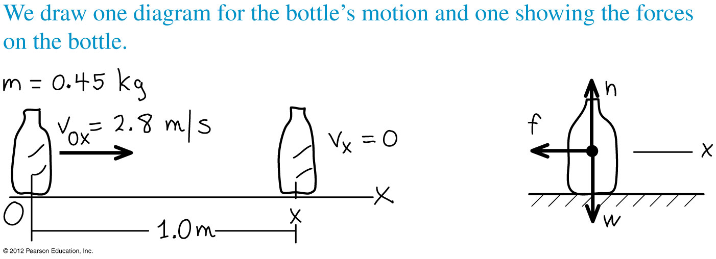
Example 3
An object with mass 0.45 kg with initial velocity of 2.8 m/s moves on a rough table. The friction force slows down the object which comes to rest after travelling 1.0 m. What are the magnitude and direction of the friction force acting on the object? You can assume a constant friction force.
Notes:
F = -1.8N. The negative sign indicates that the direction of the force is opposite to the motion.

Slide 24
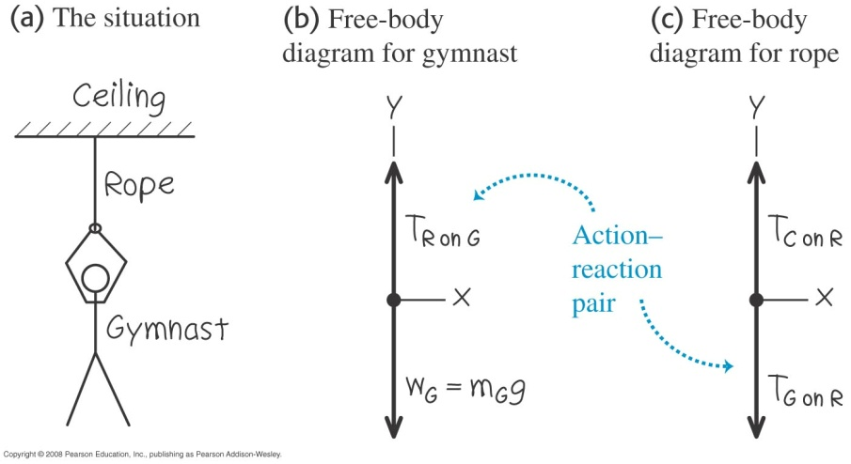
Example 4
a) A gymnast with mass m_{G} = 50.0 kg suspends herself from the lower end of a hanging rope of negligible mass. The upper end of the rope is attached to the ceiling.
i) What is the gymnast’s weight?
ii) What force (magnitude and direction) does the rope exert on her?
iii) What is the tension at the top of the rope?
b) Find the tension at each end of the rope if the weight of the rope is 120 N.
Notes:
(a) (i) W_{G} = 490 N (ii) T_{R on G} = 490 N (iii) T = 490 N
(b) T = 610 N

Slide 25
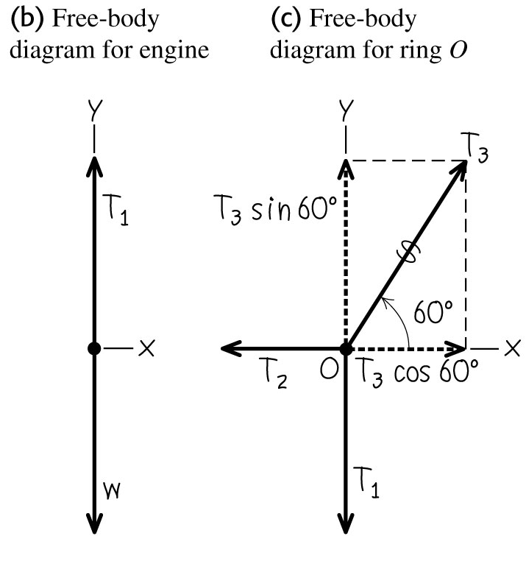
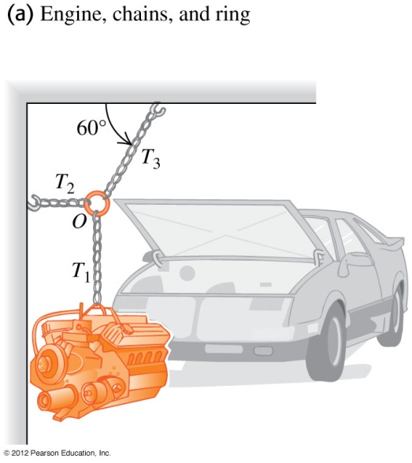
Example 5
A car engine with weight w hangs from a chain that is linked at ring O to two other chains that are attached to the ceiling and wall respectively (see figure). Find expressions for the tension in each of the three chains in terms of w. The weights of the ring and chains are negligible compared with the weight of the engine.
Notes:
T₁ = w, T₂ = 0.58 w, T₃ = 1.2 w

Slide 26
Example 6
Two blocks A and B are connected as in figure below on a smooth horizontal floor and pulled to the right with an acceleration of 2.0 m/s² by force P. If M_{A} = 50 kg and M_{B} = 10 kg, what are the values of T and P?
Mass B, it is acted on by only the tension T. Mass A is acted on by the tension T and the force P.
The weights and normal reactions of A and B are not shown because they are perpendicular to their directions of motion.
B
A
T
T
10 kg
50 kg
P
B
A
T
T
10 kg
50 kg
P

Slide 27
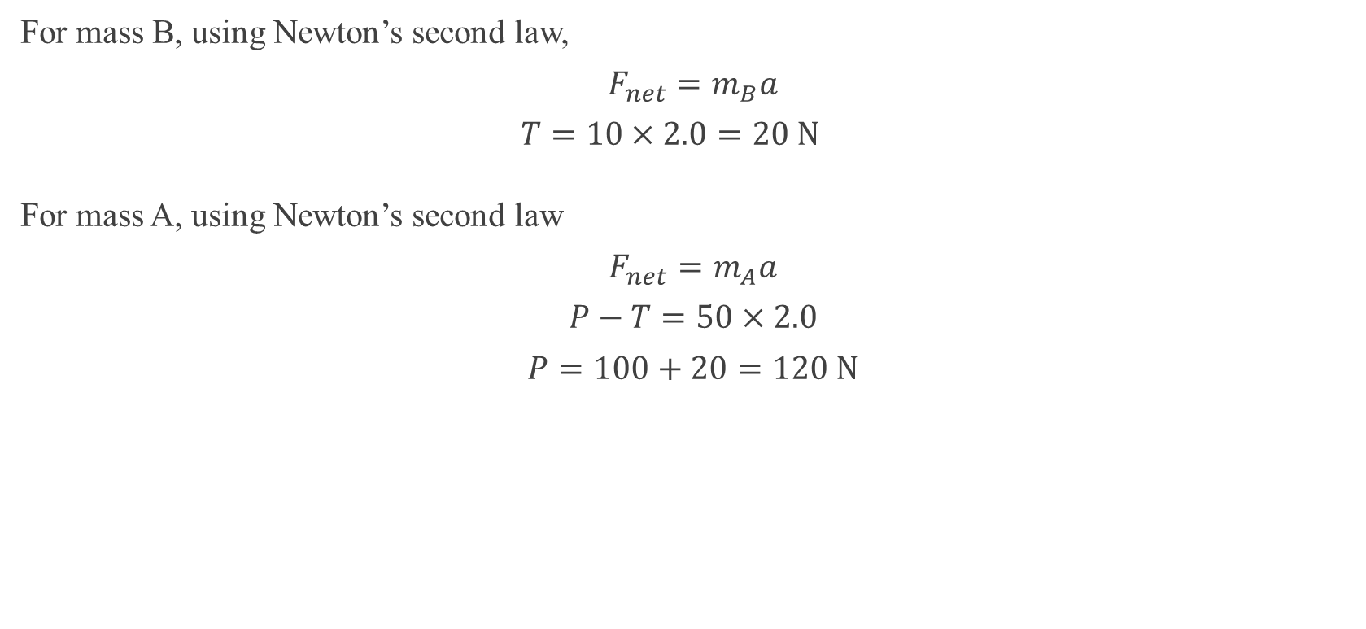
Example 6 - continue
For mass B, using Newton’s second law,
$$F_{net}=m_{B}a$$
$$T=10×2.0=20 \text{N}$$
For mass A, using Newton’s second law
$$F_{net}=m_{A}a$$
$$P−T=50×2.0$$
$$P=100+20=120 \text{N}$$

Slide 28
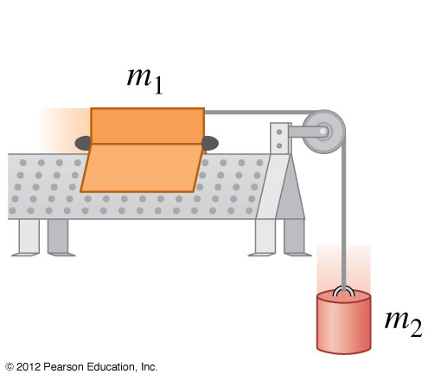
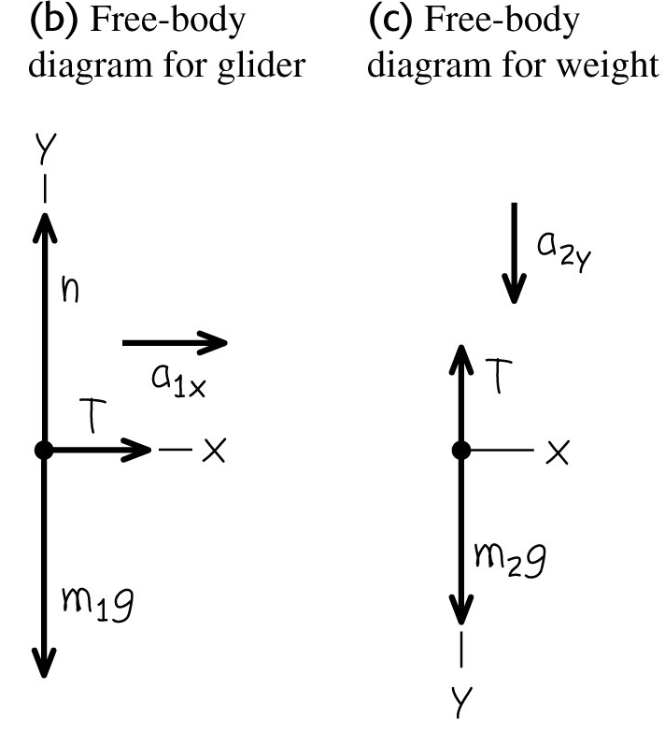
Example 7
An air-track glider with mass m₁ moves on a level, frictionless surface. The glider is connected to another object of mass m₂ through a light, flexible, non-stretching string that passes over a stationary frictionless pulley (see figure). Find the acceleration of the glider and the object as well as the tension in the string.
Notes:
Acceleration of the glider and the object is m₂g/(m₁+m₂) and Tension is (m₁m₂g)/(m₁+m₂).

Slide 29
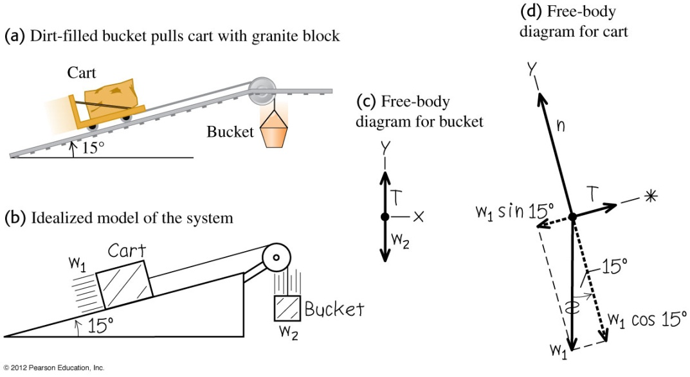
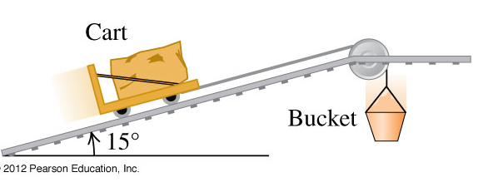
Example 8
A granite block on a cart with steel wheels (total weight of block and cart is w₁) is pulled uphill (angle of inclination is 15º) on steel rails by a dirt-filled bucket (total weight of dirt and bucket is w₂) that descends vertically downwards (see figure). How must the weights w₁ and w₂ be related in order for the system to move with constant speed? Ignore friction in the pulley and wheels and ignore weight of the cable.
Notes:
w₂ = w₁ sin15º = 0.26 w₁

Slide 30
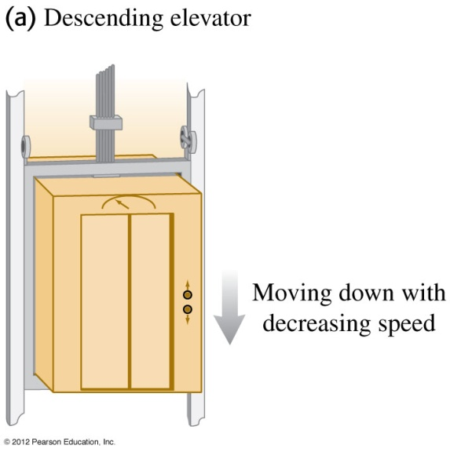
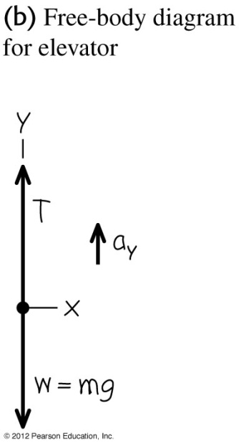
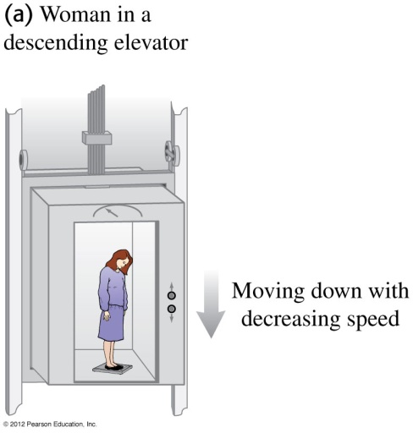
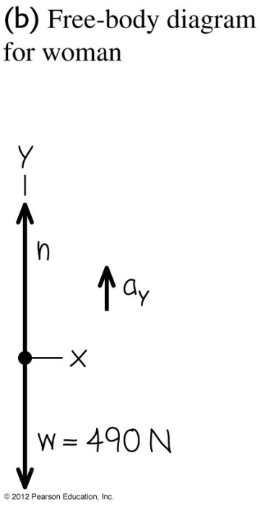
Example 9
a) An elevator and its load have a combined mass of 800 kg. The elevator is initially moving downward at 10.0 m/s ; it slows to a stop with constant acceleration in a distance of 25.0 m. What is the tension T in the supporting cable while the elevator is being brought to rest?
b) If a 50.0 kg woman stands on a bathroom scale while riding in the elevator. What is the reading on the scale?
Notes:
(a) Tension = 9440 N
(b) Reading on the scale = 590 N

Slide 31
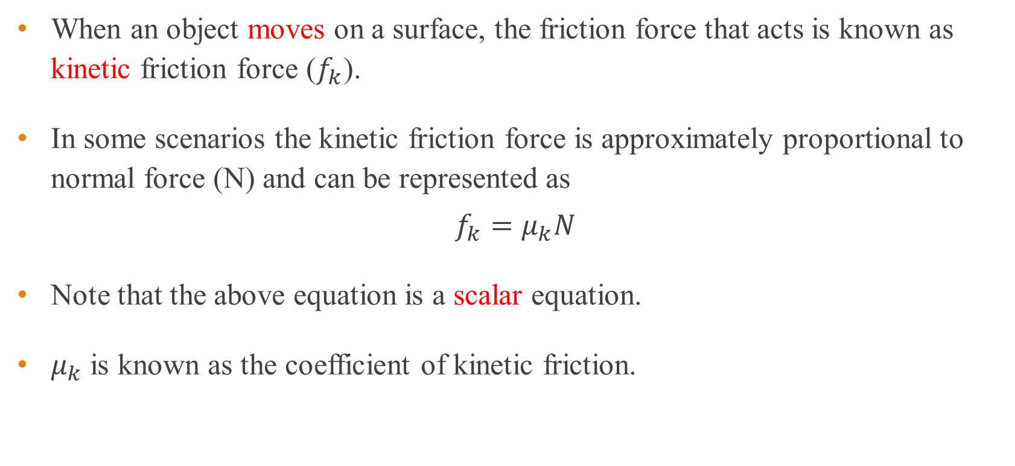
Kinetic friction
When an object moves on a surface, the friction force that acts is known as kinetic friction force ($f_{k}$).
In some scenarios the kinetic friction force is approximately proportional to normal force (N) and can be represented as
$$f_{k}=μ_{k}N$$
Note that the above equation is a scalar equation.
$μ_{k}$ is known as the coefficient of kinetic friction.

Slide 32
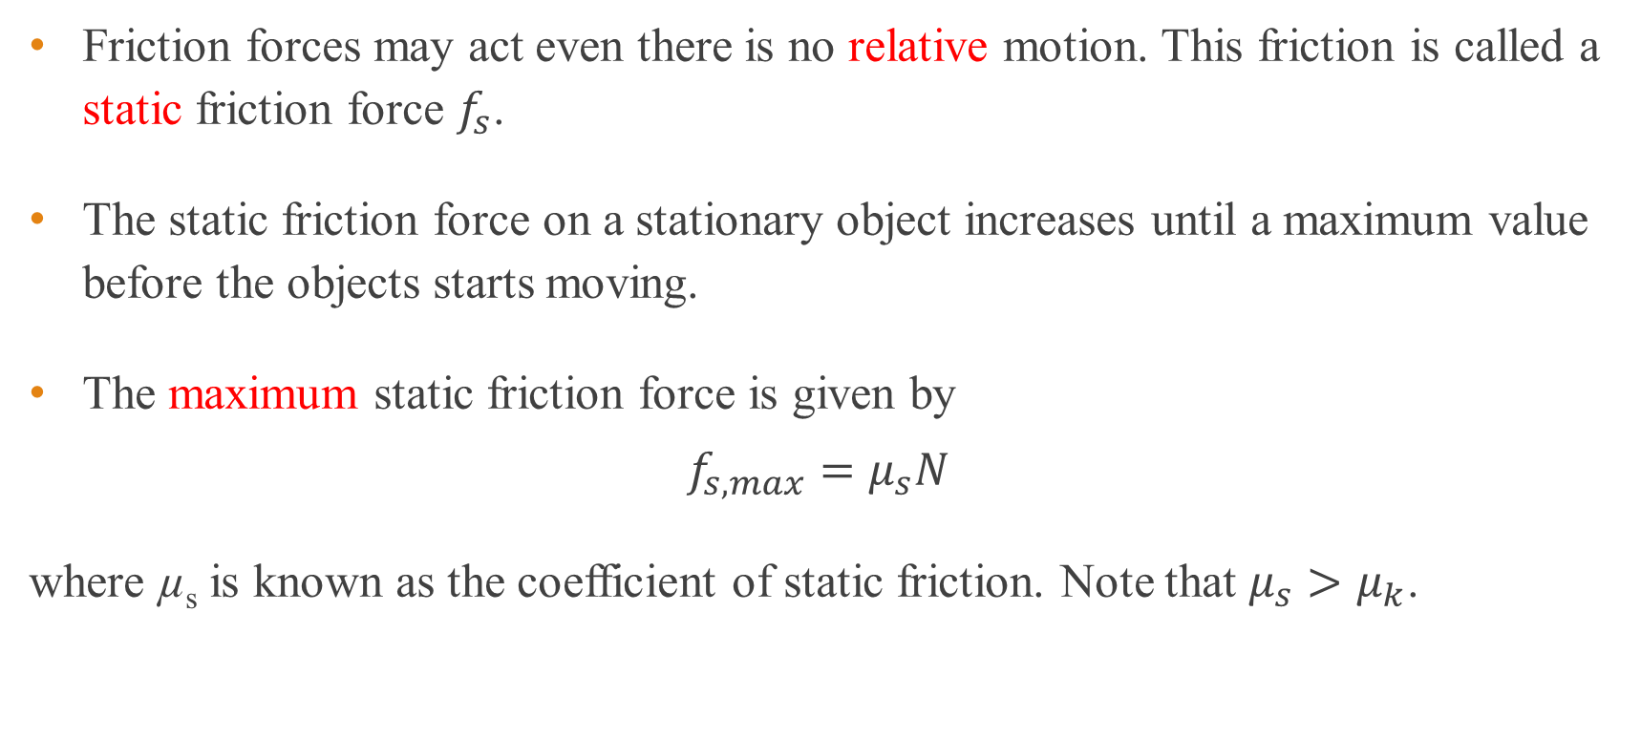
Static friction
Friction forces may act even there is no relative motion. This friction is called a static friction force $f_{s}$.
The static friction force on a stationary object increases until a maximum value before the objects starts moving.
The maximum static friction force is given by
$$f_{s, max}=μ_{s}N$$
where µ_{s} is known as the coefficient of static friction. Note that $μ_{s}>μ_{k}$.

Slide 33
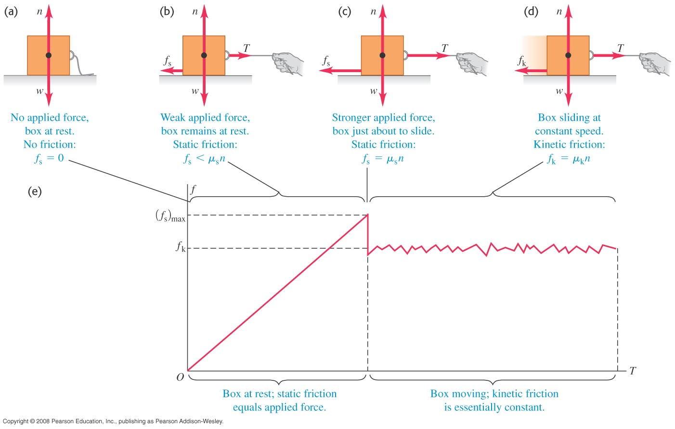
From static to kinetic friction
The figures at right show the various scenarios and the friction force involved.

Slide 34
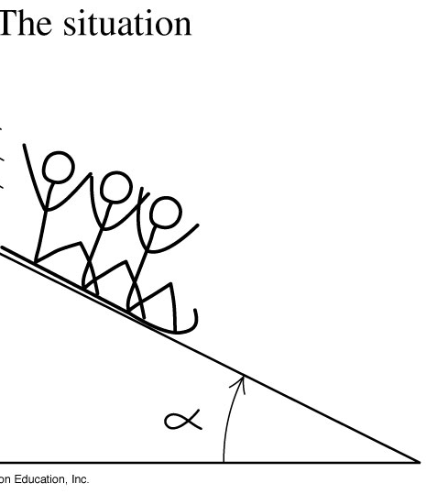
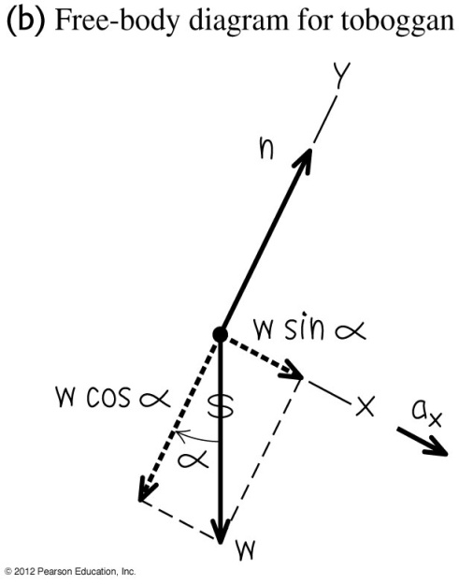
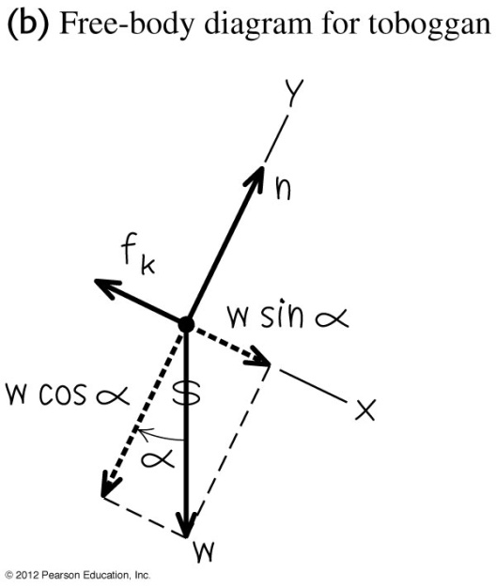
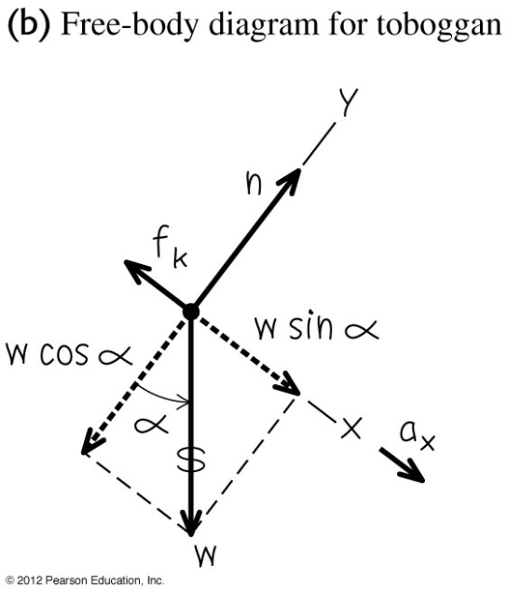
Example 10
A toboggan loaded with students (total weight w) slides down a snow-covered slope.
a) Assuming no friction what is the acceleration of toboggan if the hill slopes at a constant angle α?
b) Assuming friction with coefficient of kinetic friction µ_{k}, what should be the angle so that the toboggan slides at constant velocity?
c) Assuming friction with coefficient of kinetic friction µ_{k}, what should be the acceleration of the toboggan in terms of α, µ_{k}, g, and w?
(a)
(b)
(c)
Notes:
(a) a = g sin α, (b) α = tan⁻¹(µ_{k}), (c) a = g (sin α - µ_{k} cos α)

Slide 35
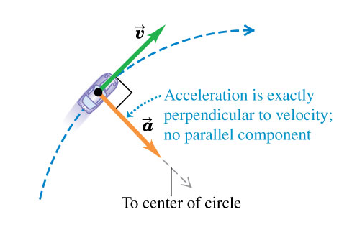
Uniform circular motion
When a particle moves in a circle with constant speed, the motion is called uniform circular motion.
There is only the perpendicular component of acceleration directed inward, which is a result of the change in direction of the particle.

Slide 36
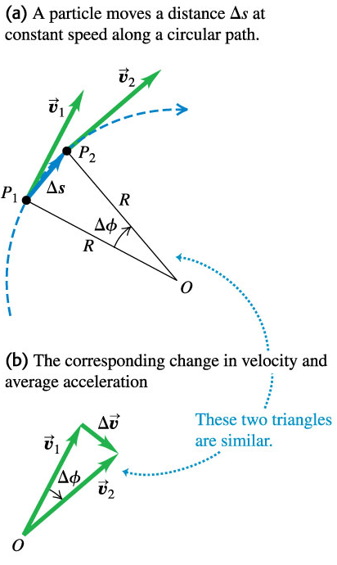
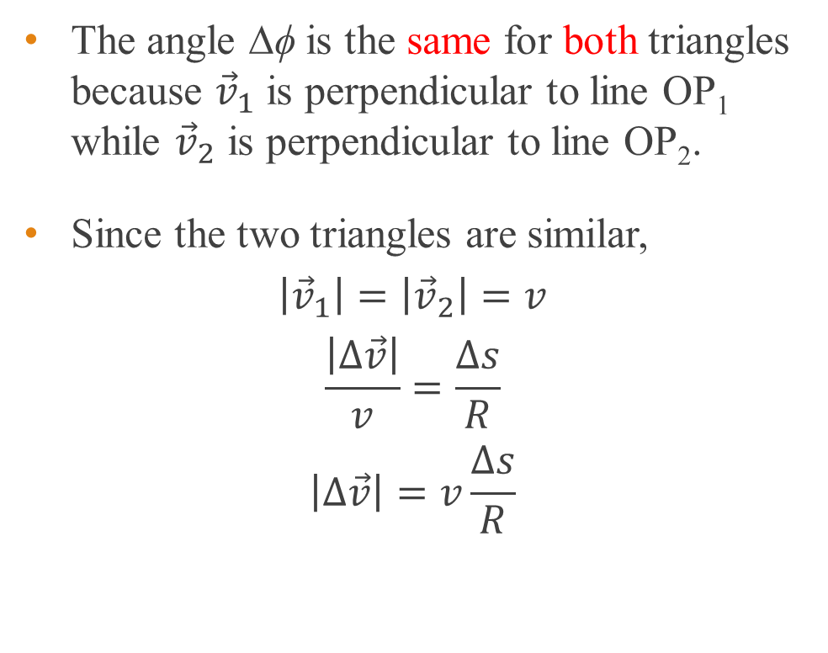
Centripetal acceleration
The angle ∆ϕ is the same for both triangles because ${\vec{v}}_{1}$ is perpendicular to line OP₁ while ${\vec{v}}_{2}$ is perpendicular to line OP₂.
Since the two triangles are similar,
$$\left|{\vec{v}}_{1}\right|=\left|{\vec{v}}_{2}\right|=v$$
$$\frac{\left|Δ\vec{v}\right|}{v}=\frac{Δs}{R}$$
$$\left|Δ\vec{v}\right|=v\frac{Δs}{R}$$

Slide 37
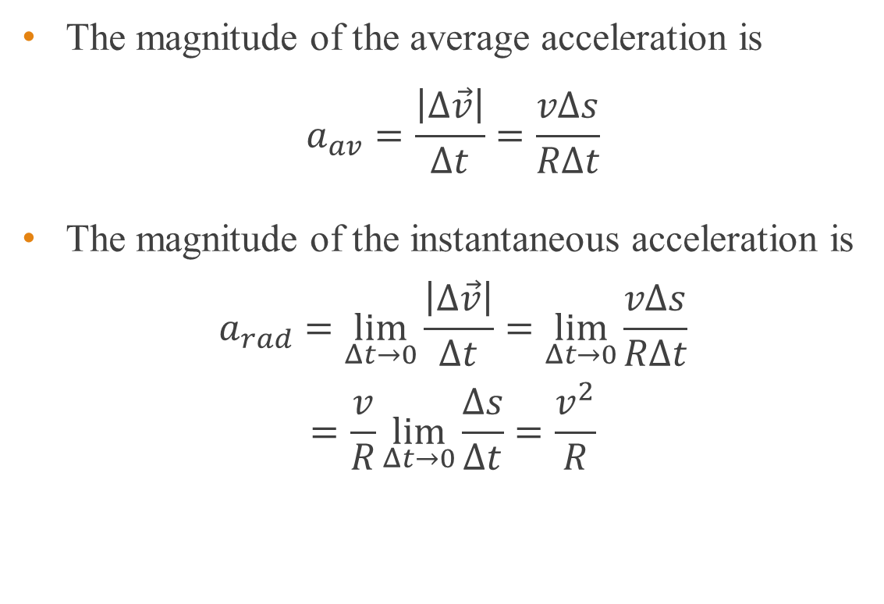
Centripetal acceleration
The magnitude of the average acceleration is
$$a_{av}=\frac{\left|Δ\vec{v}\right|}{Δt}=\frac{vΔs}{RΔt}$$
The magnitude of the instantaneous acceleration is
$$a_{rad}=\lim_{Δt→0}{\frac{\left|Δ\vec{v}\right|}{Δt}}=\lim_{Δt→0}{\frac{vΔs}{RΔt}}$$
$$=\frac{v}{R}\lim_{Δt→0}{\frac{Δs}{Δt}}=\frac{v^{2}}{R}$$

Slide 38
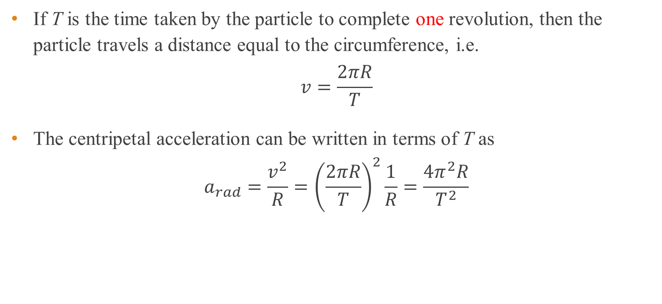
Period of revolution
If T is the time taken by the particle to complete one revolution, then the particle travels a distance equal to the circumference, i.e.
$$v=\frac{2πR}{T}$$
The centripetal acceleration can be written in terms of T as
$$a_{rad}=\frac{v^{2}}{R}={\left(\frac{2πR}{T}\right)}^{2}\frac{1}{R}=\frac{4π^{2}R}{T^{2}}$$

Slide 39
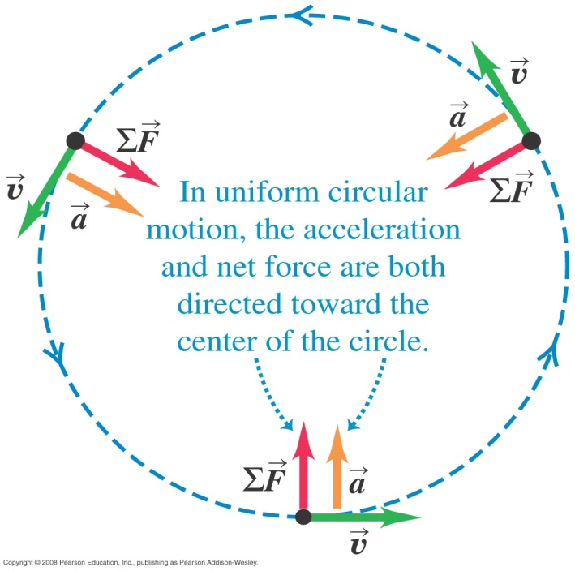
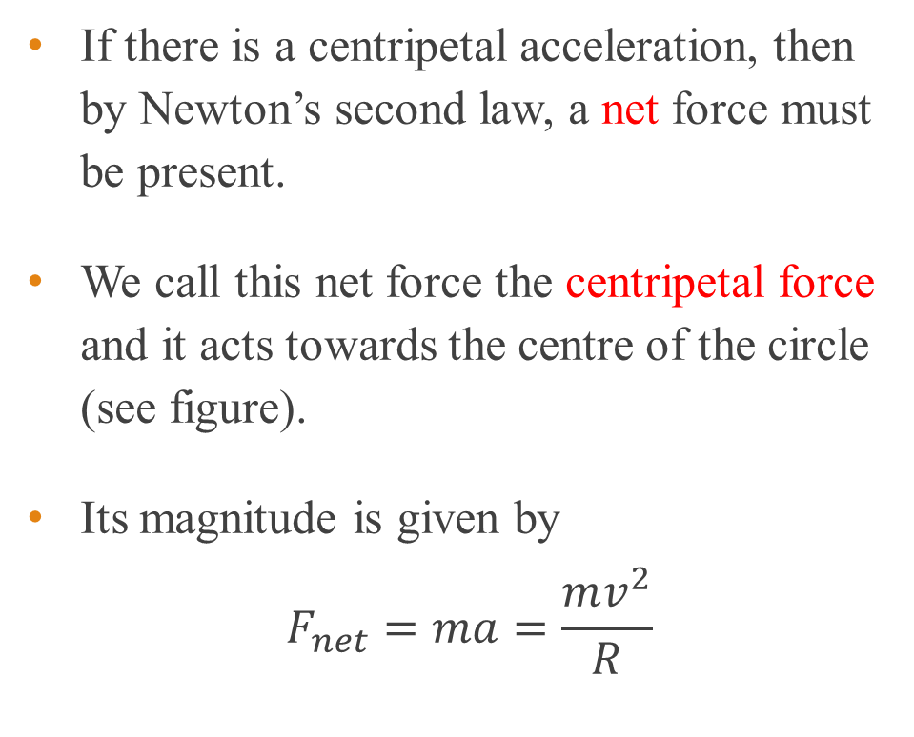
Centripetal force
If there is a centripetal acceleration, then by Newton’s second law, a net force must be present.
We call this net force the centripetal force and it acts towards the centre of the circle (see figure).
Its magnitude is given by
$$F_{net}=ma=\frac{mv^{2}}{R}$$

Slide 40
Some useful things to remember
The centripetal acceleration is directed towards the centre of the circular path.
The centripetal force
points towards the centre of the circular path.
prevents the particle from travelling in a tangential direction.
is perpendicular to the displacement of the particle and does no work on the particle.

Slide 41
Example 11
a) An object moves along a circle or a circular arc with a constant speed is accelerating.
i) Why is it accelerating?
ii) What is its acceleration?
b) For a body to move in a circular path, a force must act on it from outside the body.
i) What is this required force?
ii) What is providing this required force?
Notes:
The direction of the velocity is changing due to the net force which is the centripetal force b) v²/R
b) The required force or the net force is the centripetal force if it moves at a constant force. b)Tension, gravity etc together may add up to centripetal force. For a non-uniform circular motion the net force is a result of the centripetal and tangetial forces.

Slide 42
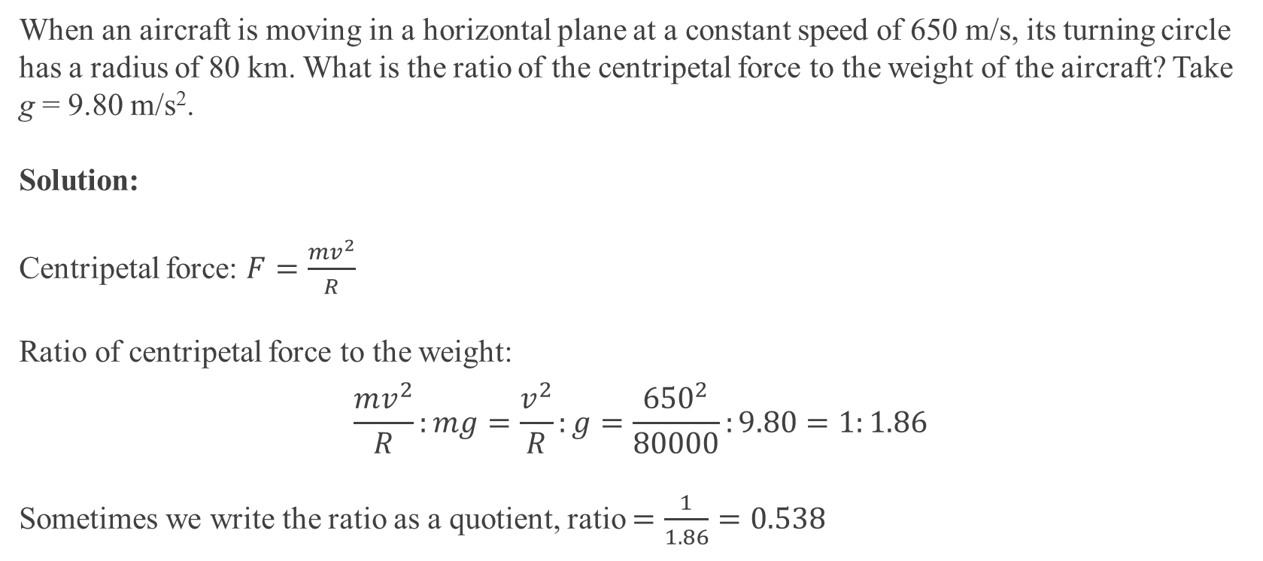
Example 12
When an aircraft is moving in a horizontal plane at a constant speed of 650 m/s, its turning circle has a radius of 80 km. What is the ratio of the centripetal force to the weight of the aircraft? Take g = 9.80 m/s².
Solution:
Centripetal force: $F=\frac{mv^{2}}{R}$
Ratio of centripetal force to the weight:
$$\frac{mv^{2}}{R}:mg=\frac{v^{2}}{R}:g=\frac{{650}^{2}}{80000}:9.80=1:1.86$$
Sometimes we write the ratio as a quotient, ratio $=\frac{1}{1.86}=0.538$

Slide 43
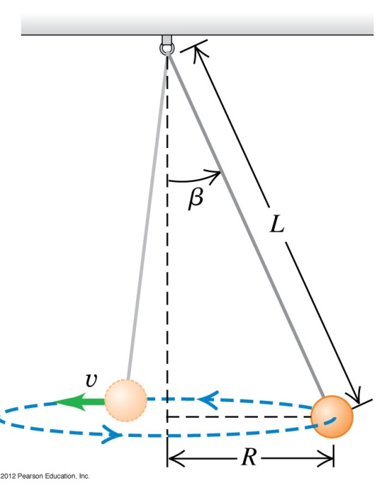
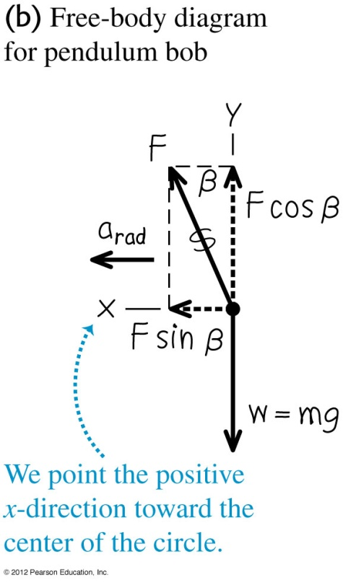
Example 13
A inventor designs a pendulum clock using a bob with mass m at the end of a thin wire of length L. Instead of swinging back and forth, the bob is to move in a horizontal circle with constant speed v with the wire making a fixed angle β with the vertical direction (see figure). This is called a conical pendulum because the suspending wire traces out a cone. Find the tension F in the wire and the period T (the time for one revolution of the bob).
Notes:
F = mg/cos β, T = 2π√(L cos β/g)

Slide 44
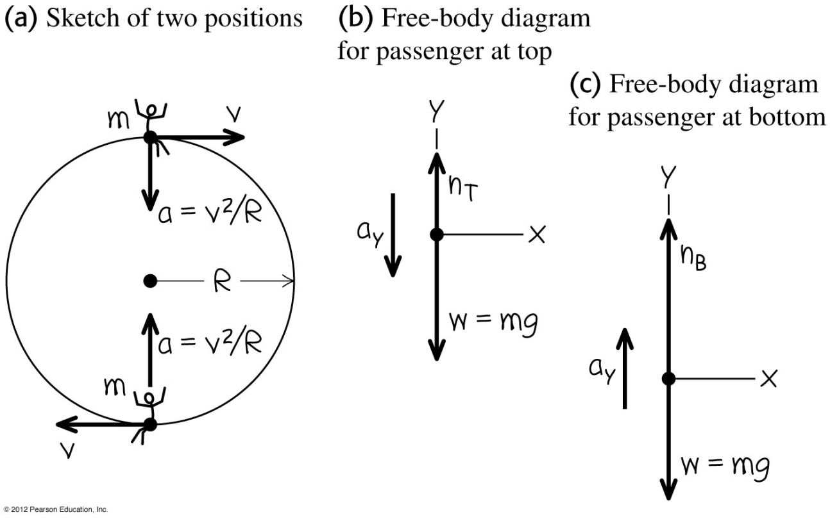
Example 14
A passenger on a carnival Ferris wheel moves in a vertical circle of radius R with constant speed v. The seat remains upright during the motion. Find expressions for the force the seat exerts on the passenger at the top of the circle and at the bottom.
Notes:
Top: N_{top} = mg (1 – v²/gR), Bottom: N_{bottom}= mg (1 + v²/gR)

Slide 45
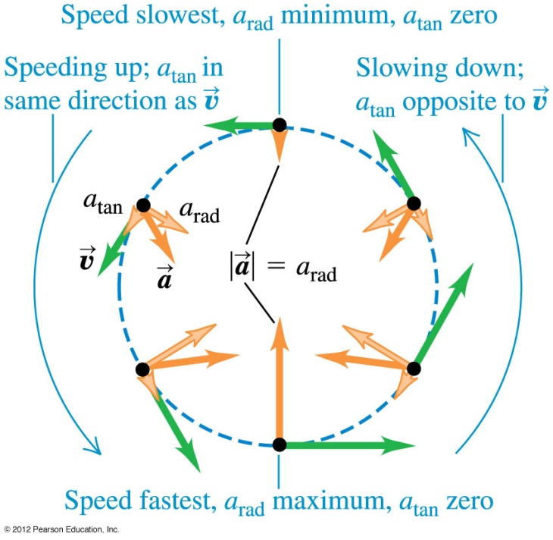
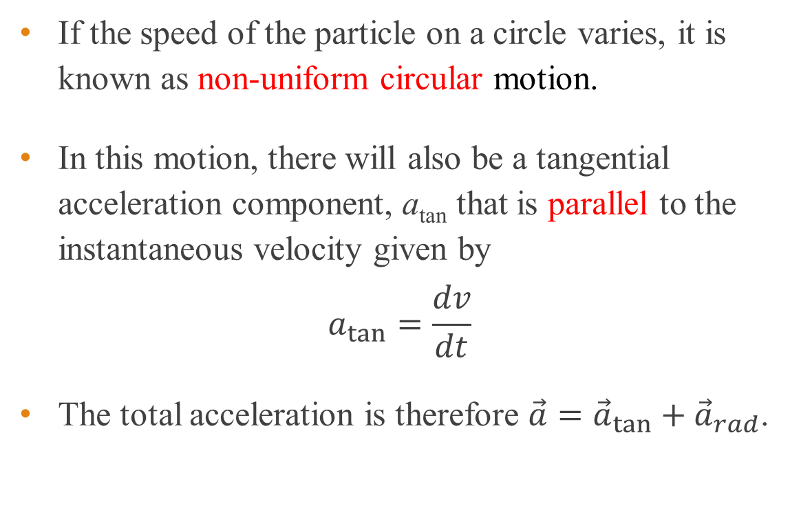
Non-uniform circular motion
If the speed of the particle on a circle varies, it is known as non-uniform circular motion.
In this motion, there will also be a tangential acceleration component, a_{tan} that is parallel to the instantaneous velocity given by
$$a_{tan}=\frac{dv}{dt}$$
The total acceleration is therefore $\vec{a}={\vec{a}}_{tan}+{\vec{a}}_{rad}$.

Slide 46
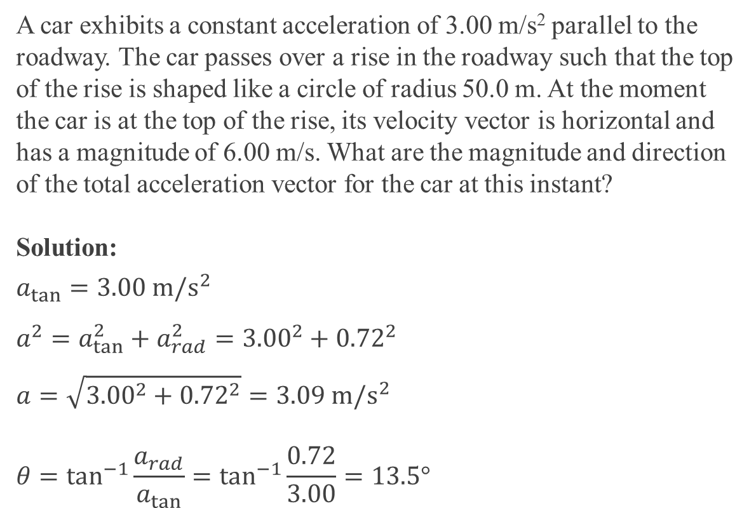
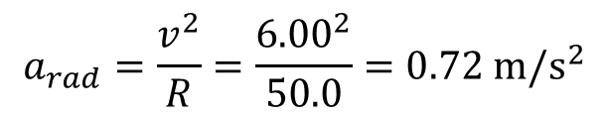
Example 15
A car exhibits a constant acceleration of 3.00 m/s² parallel to the roadway. The car passes over a rise in the roadway such that the top of the rise is shaped like a circle of radius 50.0 m. At the moment the car is at the top of the rise, its velocity vector is horizontal and has a magnitude of 6.00 m/s. What are the magnitude and direction of the total acceleration vector for the car at this instant?
Solution:
$$a_{tan}=3.00 m/s^{2}$$
$$a^{2}=a_{tan}^{2}+a_{rad}^{2}={3.00}^{2}+{0.72}^{2}$$
$$a=\sqrt{{3.00}^{2}+{0.72}^{2}}=3.09 m/s^{2}$$
$$θ=\tan^{−1}{\frac{a_{rad}}{a_{tan}}}=\tan^{−1}{\frac{0.72}{3.00}}=13.5°$$
3.00 m/s²
θ
a m/s²
0.72 m/s²
$$a_{rad}=\frac{v^{2}}{R}=\frac{{6.00}^{2}}{50.0}=0.72 m/s^{2}$$

Slide 47
Optional Slides

Slide 48

Fluid resistance force
If an object moves in a fluid, it experiences resistance to its motion.
For small objects with very low speeds the magnitude of the fluid resistance force f depends directly on the velocity as
$$f=kv$$
where k is a constant that depends on the shape and size of the body and properties of the fluid.
Examples of small objects are dust particles falling in air or a ball bearing falling in oil.

Slide 49

Terminal velocity
Consider a metal ball falling in oil such that the resistance force is $f=kv$.
According to Newton’s second law, $∑F_{y}=mg+\left(−kv_{y}\right)=ma_{y}$
As the ball falls, the speed increases, which will also increase the resistance force.
At a certain point of time, the weight of the object will equal the resistance force.
$$∑F_{y}=mg+\left(−kv_{y}\right)=0 \text{or} v_{y}=v_{t}=\frac{mg}{k}$$

Slide 50


Terminal velocity – detailed calculation
Before reaching terminal velocity, $∑F_{y}=mg+\left(−kv_{y}\right)=ma_{y}$
$$m\frac{dv_{y}}{dt}=mg−kv_{y}$$
Solving the above equation with $v_{y}=0$, when $t=0$, we get
$$v_{y}=v_{t}\left[1−e^{−\left(k/m\right)t}\right], a_{y}=\frac{dv_{y}}{dt}=ge^{−\left(k/m\right)t}, y=v_{t}\left[t−\frac{m}{k}\left(1−e^{−\left(k/m\right)t}\right)\right]$$

Slide 51

Air drag
For larger objects moving through air at high speeds, the resisting force is approximately proportional to $v^{2}$.
This kind of resisting force is called air drag or simply drag. Airplanes, falling rain drops and bicyclists all experience air drag.
Air drag can be expressed as $f=Dv^{2}$
where ‘D’ is a constant that depends on the shape and size of the body and the density of air.
The terminal velocity of objects under air drag is given by $v_{t}=\sqrt{\frac{mg}{D}}$

Slide 52
End of chapter

